Slide 1
Lecture 1: Introduction
The constructive tradition
Computational approach to visual perception
Bayesian approach to visual perception

Slide 2
The constructivist tradition

Slide 3
Two questions to psychologists
Truth exists as mental constructions (idealism, Plato) or truth as experience (phenomenalism, George Berkeley)
What is the truth?
  Ontology
How do we know it?
  Epistemology
Truth exists objectively in the world (ecological realism)
Indirectly – represent, construct
Directly – via physical interactions

Slide 4
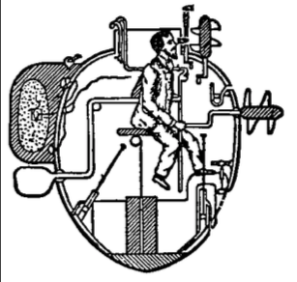
The traditional idea… (constructivism)
The submarine metaphor:
We work with periscope images of the world to know the real world
We control the knobs and levers to move the body
INDIRECT
Notes:
We are in contact with an internal representation (the periscope images) of the world, not the world itself.
We control an internal model of the body (the knobs and levers inside the submarine) and not the body itself.

Slide 5
The fundamental problem of visual perception
We see 3D objects with clearly defined boundaries, shapes, sizes, colors, surface orientations, textures etc.
Our visual system begins with 2D images
How to perceive the 3D world (distal stimulus) from the given 2D images (proximal stimulus)?
Notes:
This is the fundamental problem of visual perception
In general, this problem can be understood as: how do you overcome sensory limitations to perceive a real, physical and continuous world. (relatedly, another problem: our eyes respond discretely to light… how do we (or, do we) know it is a continuous world?

Slide 6
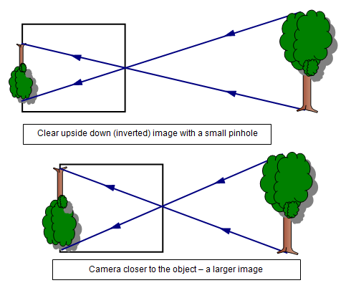
To know the world from its representations – The constructive approach
How do we see? The “traditional” way of thinking…
  Light → Retinal stimulation → neural impulses → brain computes and reconstructs the world observed
  Indirect perception – constructivism

Slide 7
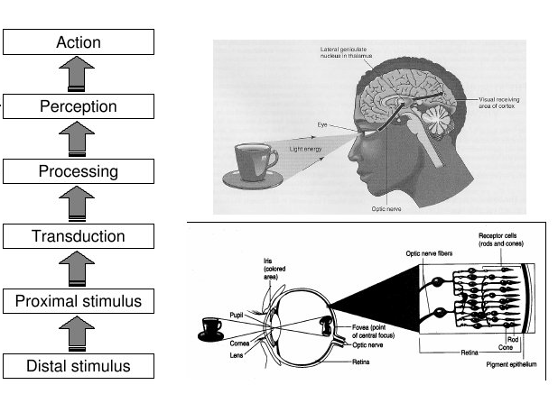
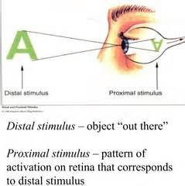
The constructive process of perception

Slide 8
The Helmholtzian Constructive Approach
S_{D}
S_{P}
s
P
3D world
2D images
Sense data
3D representation
(aka mental model)
Ambiguity
Inference
Perception (the process of) = constructing a mental representation of the real world from (impoverished) sensory input
Three features: nonspecificity, inference, and representation
This approach is labelled: indirect, inferential, or representational

Slide 9
The Helmholtzian Constructive Approach is nonspecific
S_{D}
S_{P}
s
3D world
2D images
Sense data
Ambiguity
The goal of perception is to get a Euclidean description of the world, or to recover S_{D}
But S_{P} is non-specific to S_{D} and sense data is even more impoverished → ambiguity
Perception is undermined by the impoverished information and the probabilistic ( = nondeterministic) cues

Slide 10
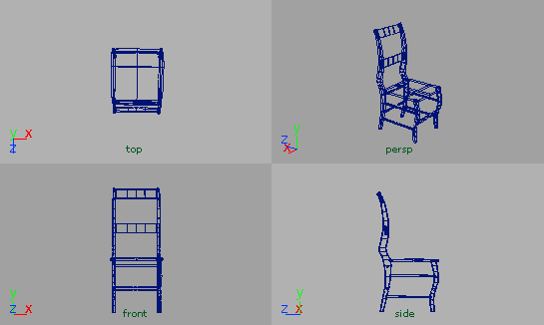
Non-specificity between S_{D} and S_{P}
Are images projected on the retina similar to the actual world objects?
Many – to –one mapping
Real Image
objects
Different objects, same image.
Same object, different images.
One – to – many mapping
Real Image
objects

Slide 11
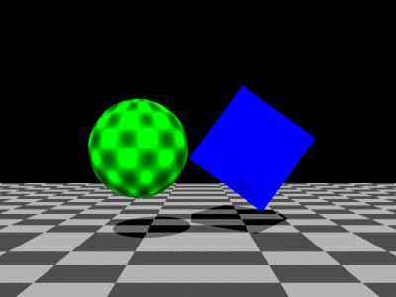
Non-specificity between S_{D} and S_{P}
Are images projected on the retina similar to the actual world objects?
What are the shapes that cast these shadows?
What are the shapes? How thick or flat are they?

Slide 13
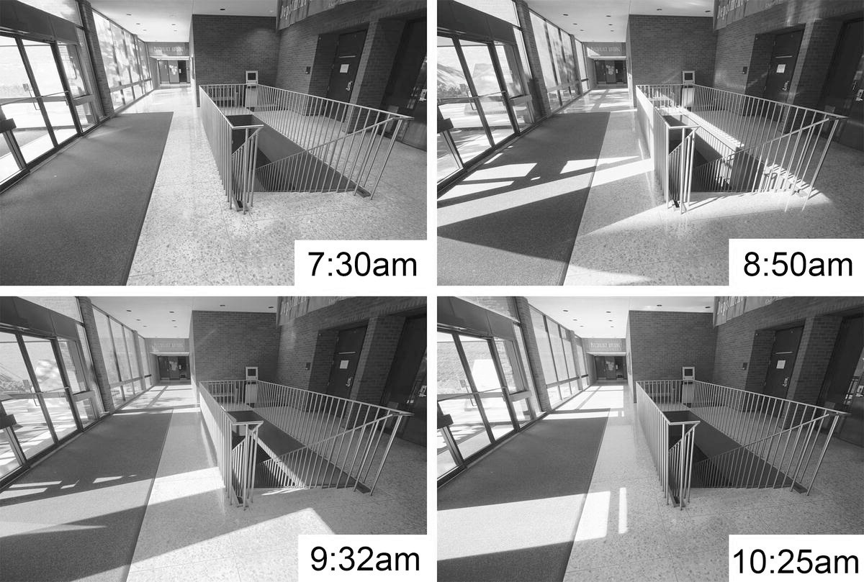

Slide 16
The Helmholtzian Constructive Approach is inferential
S_{D}
S_{P}
s
P
3D world
2D images
Sense data
3D representation
(aka mental model)
Ambiguity
Inference
Because sense data is impoverished, we must go beyond the information – Helmholtz “unconscious inference”
Making inference based on prior knowledge -- assumptions, biases, memory, inference rules ...
Not objective
Notes:
The bottomline is: how does everyone see the same world?

Slide 17
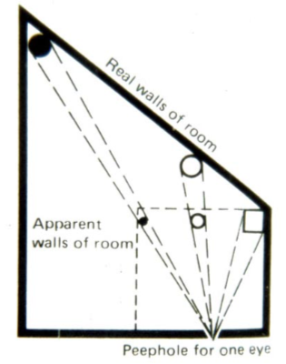
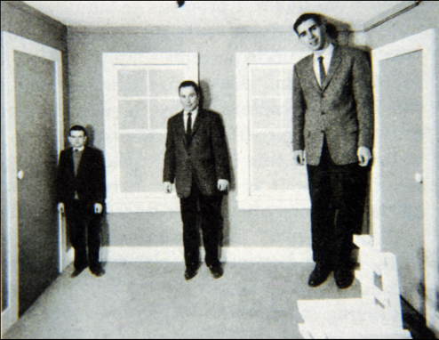
Prior knowledge or assumptions affect our perception:
The Ames Room

Slide 18
S_{D1}
S_{D2}
s
d
How do we know the object’s size (S_{D}) based on sense data (s)?
Perceive distance (d) and infer S_{D} given s.
Inference rule: S_{D} = f(s, d) – size-distance invariance
But how do you know d? Use object’s size as cue – bigger objects are normally closer
Problematic? You are substituting one problem (perceiving size) with another (perceiving distance)

Slide 19
The Helmholtzian Constructive Approach is representational
S_{D}
S_{P}
s
P
3D world
2D images
Sense data
3D representation
(aka mental model)
P is an internal (mental) representation of S_{D}
Observer is in contact with the representation, not the world itself (indirect perception)
Problems:
1. who interprets the representation? How to make sure that the interpretations are similar enough to enable inter-individual coordination/interaction?
2. How do representations get connect to the world? (David Hume)

Slide 20
The computational approach

Slide 21


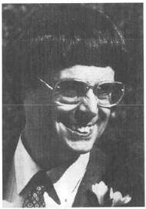
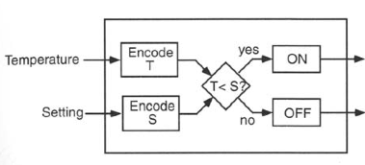
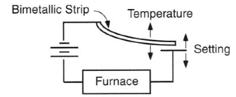
David Marr’s three levels of analysis
The thermostat metaphor
David Marr (1982) : Computational theory of vision
L1: Computational Level
L2: Algorithmic Level
L3: Implementation Level

Slide 22
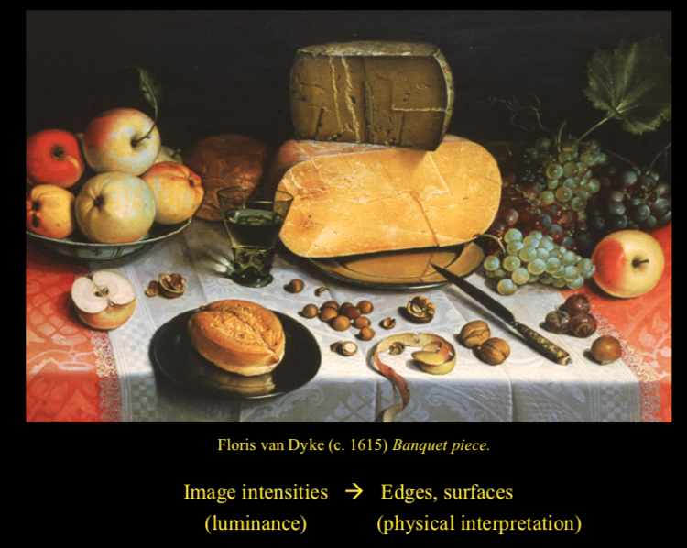
Computational level: dealing with signals (extracting information)
Algorithmic level: dealing with rules (software, putting info together)
Implementation level: handling the processes (hardware, neural circuitry)

Slide 23
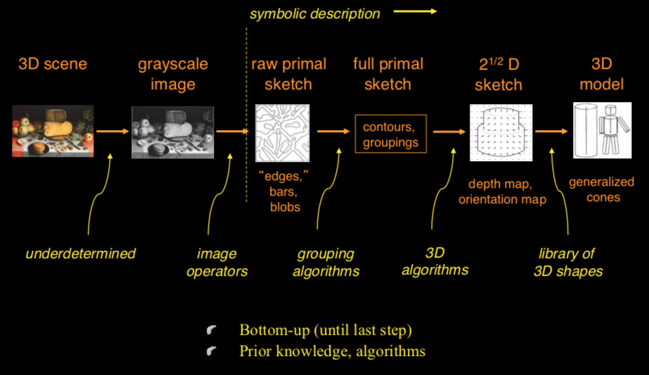

Slide 24
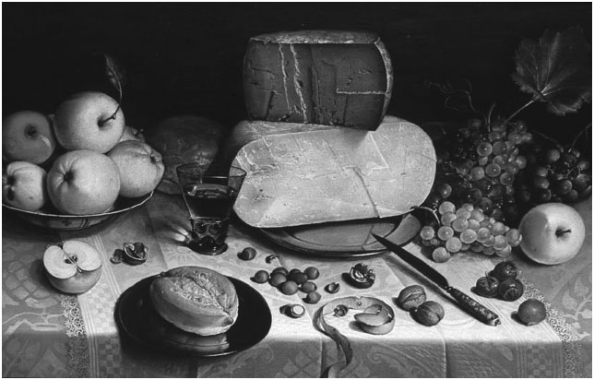
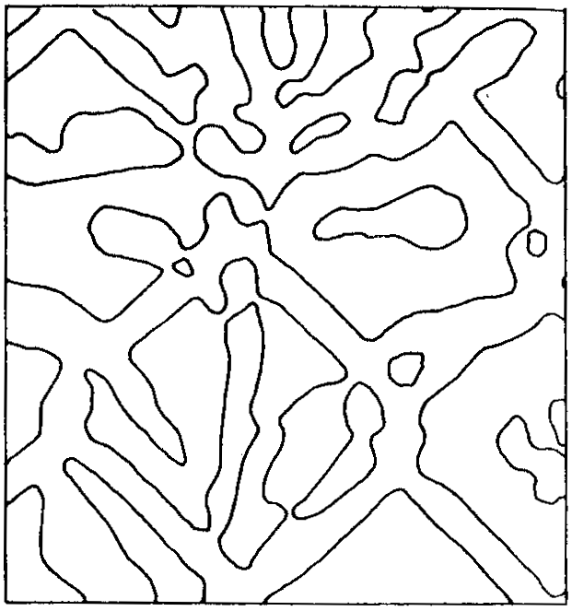
A
B
An example of image operators: The Laplacian operator
Intensity in a local area of picture A
First derivative of intensity (rate of change of intensity) = gradient
Second derivative of intensity: rate of change of gradient
0
0-crossing = boundary
0

Slide 25
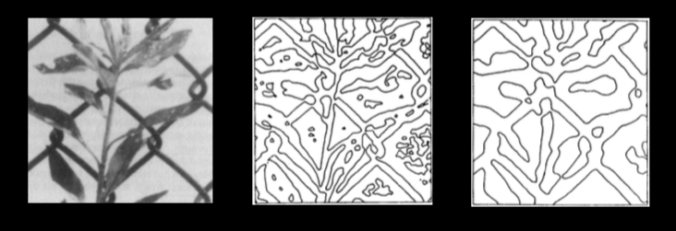
Repeat the operation at multiple scales
Common 0-crossings = best estimates of boundary/edge
Original Fine scale Course scale
PROBLEMS?
Only distinguishing intensity boundaries, but not physical edges.

Slide 26
PROBLEMS?
Only distinguishing intensity boundaries, but not physical edges.

Slide 27
Other critiques of Marr’s approach
Algorithms work in limited situations (e.g. it requires clear image input/intensity contrast)
Makes convenient assumptions (which didn’t always hold in natural scenes)
Must have an a priori goal of Euclidean structure (must know what you are looking for…inverse optics…)
This approach also suffers from similar problems of constructivism:
Nonspecificity
Inference
Representation based
Perception is indirect

Slide 28
The Bayesian approach

Slide 29
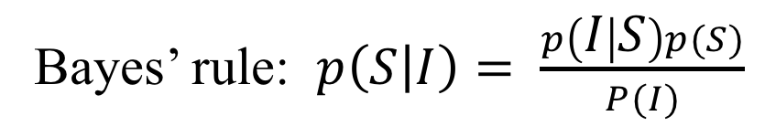
The Bayesian approach is contemporary and (still) popular
It is probabilistic (not deterministic)
It is less brittle and copes with noise in images and the sensory system
It uses Bayes’ Rule to go beyond the information give (inductive inference)
NOISE
NOISE
A (real) scene (S)
Image (I)
Percept
p(S)
Prior probability distribution
p(I|S)
Likelihood function
p(S|I)
Posterior probability distribution
Bayes’ rule: $p\left(S | I\right)= \frac{p\left(I | S\right)p(S)}{P(I)}$
Normalize to 1

Slide 30
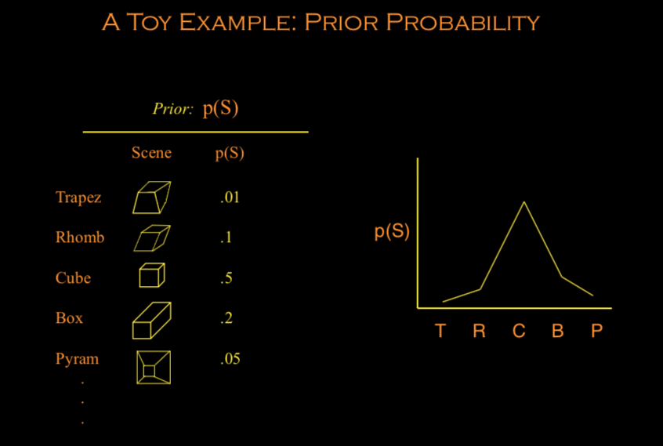
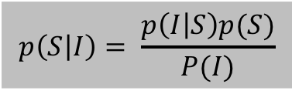
$$p\left(S | I\right)= \frac{p\left(I | S\right)p(S)}{P(I)}$$
Viewing target

Slide 31
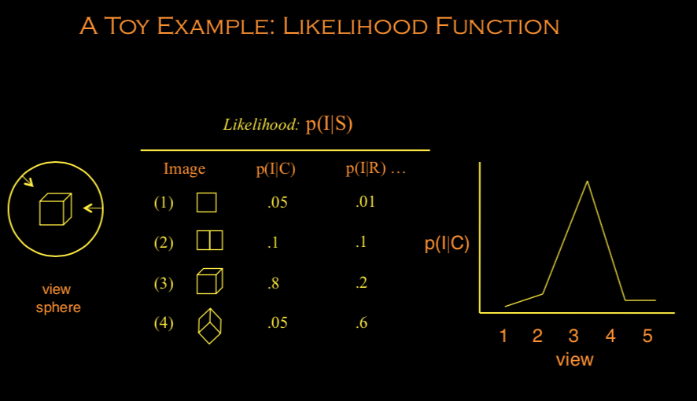

Slide 32
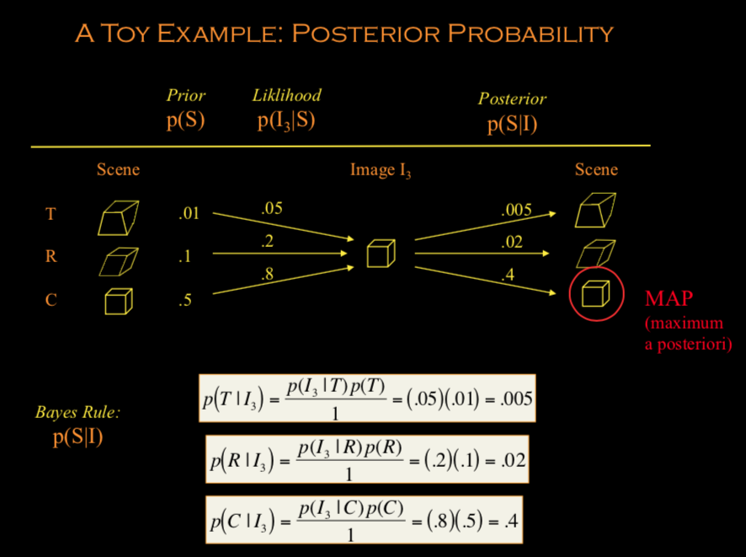

Slide 33
Critiques of the Bayesian approach
Prior? What is it?
When doing research using the Bayesian approach… the study tends to be driven by data or even experiences, instead of motivated by theories.
This approach also suffers from similar problems of constructivism:
Nonspecificity
Inference
Representation based
Perception is indirect

Slide 34
Readings
Proffitt, D. (1999) Inferential vs. ecological approaches to perception. In R.J. Sternberg (Ed.), The nature of cognition.

